Slide 2
Use of English

Slide 3
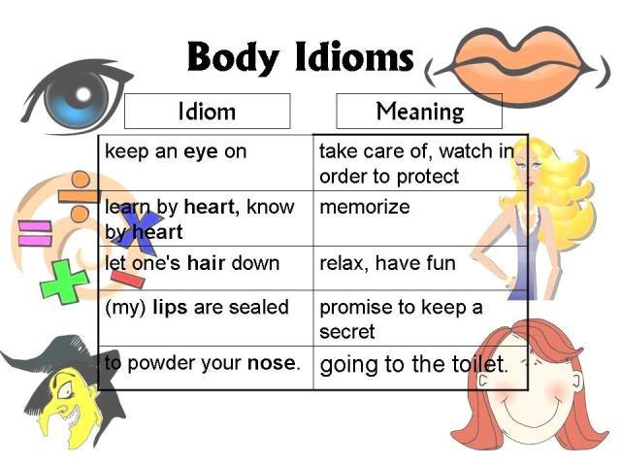
Use of English

Slide 4
Use of English

Slide 5
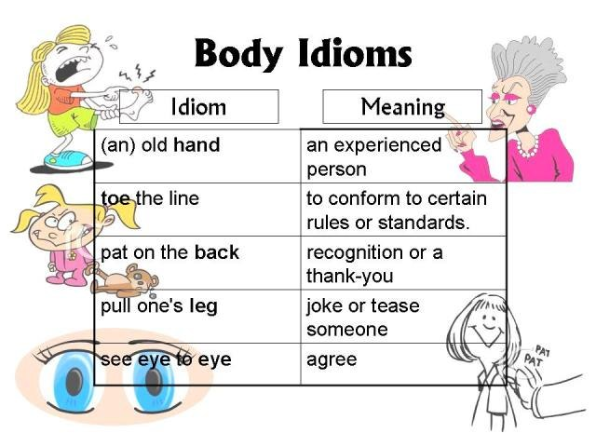
Use of English

Slide 6
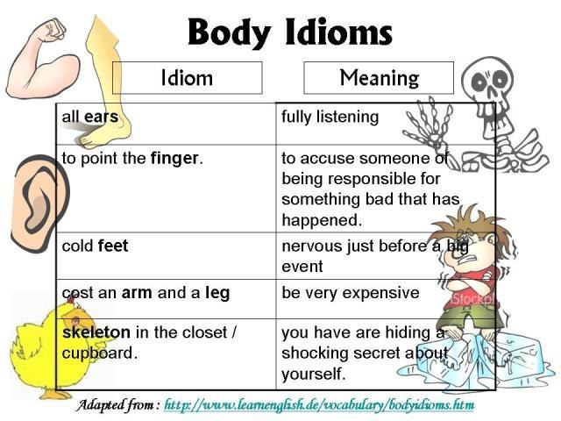
Use of English

Slide 7
Use of English

Slide 8
Use of English

Slide 9
Use of English

Slide 10
Use of English

Slide 11
Writing

Slide 12
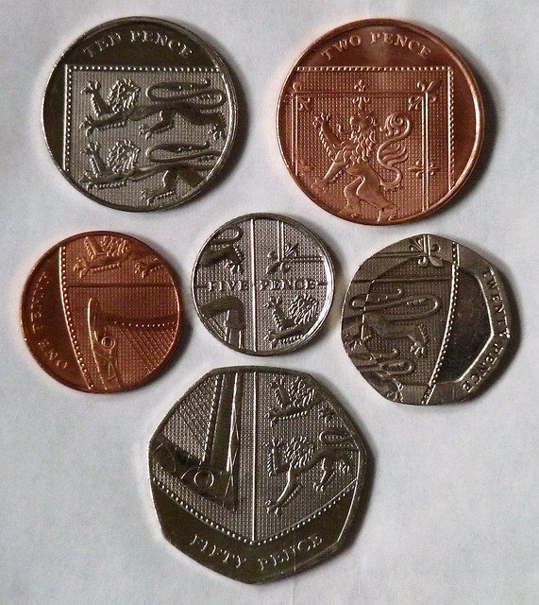

Slide 13
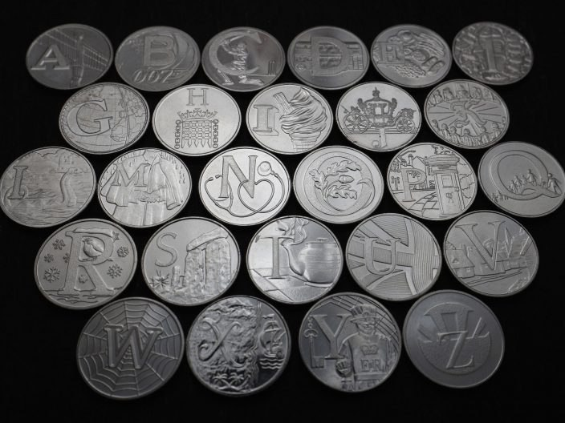

Slide 14
Links
http://upwego.ru/index.php
http://www.bbc.co.uk/learningenglish/

