Slide 1
«Система работы
по подготовке обучающихся
к выполнению
письменной части
Всероссийской олимпиады
школьников»
Костина О.Н.
учитель английского языка
Государственного бюджетного нетипового образовательного учреждения
«Архангельский государственный лицей имени М.В. Ломоносова»

Slide 2
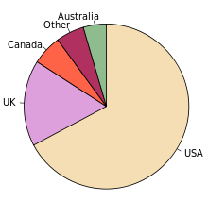
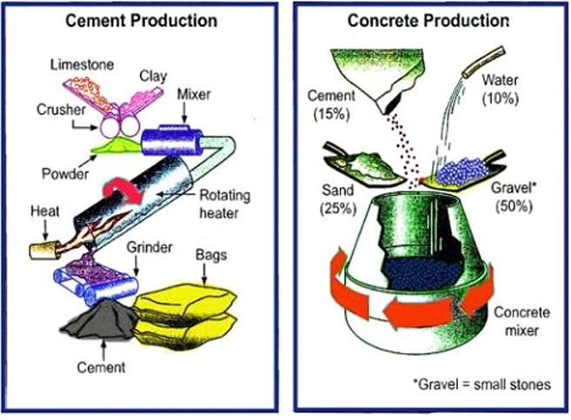
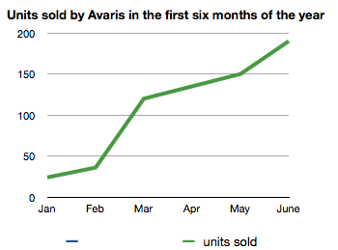
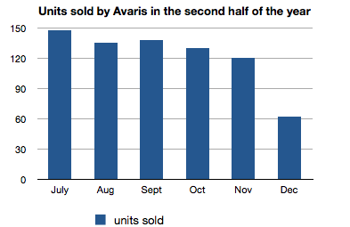
Варианты заданий для анализа
Pie charts
Process diagrams
Line graphs
 | Food and drink | Housing | Clothing | Entertainment
France | 25% | 31% | 7% | 13%
Germany | 22% | 33% | 15% | 19%
UK | 27% | 37% | 11% | 11%
Turkey | 36% | 20% | 12% | 10%
Spain | 31% | 18% | 8% | 15%
Tables
Bar charts

Slide 3
Up variations
Verb | Noun | Example
rise | a rise | It rose by 2 % There was a rise of 2%
increase | an increase | It increased by 2% There was an increase of 2%
go up | (an upturn) | It went up by 2%

Slide 4
Up variations
Verbs | Examples
soar | The price soared in November.
rocket | It then rocketed to a high of 75%.
leap | This figure leapt to 80,000 by the end of the period.
climb | The number of television sold in 2010 climbed.
surge | It then surged to a high of 75,000 units.
Notes:
“Soar “and “rocket” are both very strong words that describe large rises.
“Rocket” is more sudden. You probably do not need to qualify these verbs with adverbs.
“Leap” shows a large and sudden rise. Again, you probably do not need to qualify it with an adverb.
“Climb” is a relatively neutral verb that can be used with the adverbs below.

Slide 5
Down variations
Verbs | Nouns | Examples
fall | a fall | It fell by 3% There was a 3% fall
decrease | a decrease | It decreased by 3% There was a 3% decrease
go down | a drop | It went down by 3% There was a drop of 3%

Slide 6
Down variations
Verbs | Examples
plummet | It then plummeted to a low of 20%.
sink | After that it sank to 75.
drop | This amount dropped by 30% in the 3rd quarter of the year.
slip back | only to slip back to 900 in May
dip | The number of female doctors dipped in the last decade.
Notes:
“Plummet” is the strongest word here. It means to fall very quickly and a long way.
“Dip” and “drop” are normally used for fairly small decreases.
“Slip back” is used for falls that come after rises.
“Drop” and “Dip” are also frequently used as nouns: e.g. “a slight dip” “a sudden drop”.

Slide 7
Up and down
(Sometimes you need to describe a graph that goes up and then down)
Verbs | Nouns | Examples
fluctuate | a fluctuation | It fluctuated between 6% and 8% There was a 2% fluctuation

Slide 8
No change
Verb | Adjective | Example
stabilize | stable | It stabilized at 6% It remained stable at 6%
remain steady | steady | It remained steady at 6%
- | no change | There was no change at 6%

Slide 9
Top
Verb | Noun | Example
peak | (reach) a peak | It peaked at 10% It reached a peak of 10%

Slide 10
Adjectives
adjective | example | adverb | example
spectacular | a spectacular fall | spectacularly | fell spectacularly
dramatic | a dramatic rise | dramatically | rose dramatically
substantial | a substantial rise | substantially | rose substantially
significant | a significant fall | significantly | fell significantly
sudden | a sudden fall | suddenly | fell suddenly
sharp | a sharp decrease | sharply | sharply decreased
Notes:
“sudden” and “sharp” can be used of relatively minor changes that happen quickly.
“spectacular” and “dramatic” are very strong words only to used to big, big, big changes.

Slide 11
Steady adjectives
adjective | example | adverb | example
steady | a steady increase | steadily | increased steadily
consistent | a consistent decrease | consistently | decreased consistently
gradual | a gradual increase | gradually | increased gradually

Slide 12
Small adjectives
adjective | example | adverb | example
modest | a modest increase | modestly | increased modestly
slight | a slight rise | slightly | rose slightly
marginal | a marginal fall | marginally | fell marginally

Slide 13
Useful adjectives
These adjectives can be used to describes more general trends
adjective | example
overall | It is evident that the overall trend was consistently upwards.
downward | … showed a downward trend throughout the period …
upward | This upward trend finished in 2010.
Notes:
“overall” can be used to describe changes in trend over the whole period: very useful in introductions and conclusions
“upward” and “downward” are adjectives: the adverbs are “upwards” and “downwards”

Slide 14
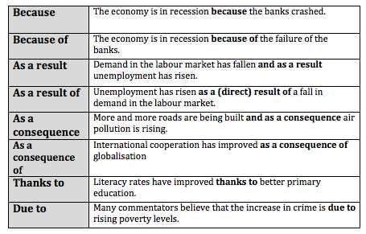
Notes:
because” , ‘as a result” and “as a consequence” are used with a verb and “because of”, ”as a result of” and “as a consequence of” with a noun;
some people believe you shouldn’t start sentences with “because”. This is rubbish but in the exam it may be sensible not to do it
“due to” is normally used with negative situations and “thanks to with “positive situations”

Slide 15
Cause verbs
A useful variation is to use “because” as a verb.
Here are the 3 main variations
Cause | Violence in films has probably caused crime to rise.
Lead to | Intensive farming has led to many smallholders becoming unemployed.
Result in | Poor diet and lack of exercise has resulted in generation who will die younger than their parents.
Notes:
You cause something to happen but it results in something happening

Slide 16
These verbs can also sometimes be used
to describe cause and effect
Make | Certain stars from the world of entertainment deserve their salaries as they make many people very happy.
Create | Excess consumption of fossil fuel has helped to create many of the environmental problems today.
Change | Mass immigration has undoubtedly changed many societies.
Affect | The problems of air pollution affect the quality of life in many parts of the world.
Notes:
Please note the spelling of “affect” as a verb and do not confuse it with “effect” the noun.

Slide 17
Nouns
The essential nouns are of course “cause” and “effect” but there are alternatives
Cause | One cause of this problem is a fall in educational standards.
Reason | There is a variety of reasons why this has happened / for this.
Effect | Falling educational standards have had a variety of negative effects.
Result | One positive result of this would be better international cooperation.
Notes:
You talk about the cause of something but the reason for it.

Slide 18
Put in the correct prepositions:
It is now almost certain that global warming has been directly caused (1) ___ man’s use of fossil fuels. This has led (2) ___ an international debate about what we should do to reduce the negative effects (3) ___ our actions and how we can make the planet safe for our children’s children to live in. One consequence (4) ___ this debate has been to improve the level of “green” education in schools and this should result (5) ___ greater awareness of this difficult issue in the long term. However, in the short term there still remains much to be done. The reason (6) ___ this is that we need to address causes (7) ___ the immediate problem

Slide 19
Answers:
by
to
of
of
in
for
of

Slide 20
How to change percentages
to fractions or ratios
Percentage | Fraction
80% | four-fifths
75% | three-quarters
70% | seven in ten
65% | two-thirds
60% | three-fifths
55% | more than half
50% | half
45% | more than two fifths
40% | two-fifths
35% | more than a third
30% | less than a third
25% | a quarter
20% | a fifth
15% | less than a fifth
10% | one in ten
5% | one in twenty

Slide 21
If the percentages are not exact as above, then you can use qualifiers to make sure your description remains accurate
Percentage | Qualifier
77% | just over three quarters
77% | approximately three quarters
49% | just under a half
49% | nearly a half
32% | almost a third

Slide 22
How to change percentages to other phrases
Percentage | proportion / number / amount / majority / minority
75% - 85% | a very large majority
65% - 75% | a significant proportion
10% - 15% | a minority
5% | a very small number

Slide 23
English | Russian
The chart is about ... | данная диаграмма о ...
The bar chart deals with ... | гистограмма имеет дело с ...
The line graph clearly shows ... | линия графика ясно показывает ...
The pie chart compares the ... | круговая диаграмма сравнивает ...
The chart is divided into ... parts. | диаграмма разбита на ... частей.
According to the graph ... | согласно графика ...
As it may be seen from the chart ... | как это видно из диаграммы ...
As the chart illustrates... | как диаграмма иллюстрирует ...
The graph presents data showing... | на графике представлены данные, показывающие ...
The chart plainly indicates that... | диаграмма ясно указывает, что ...
As it is evident from the graph ... | как видно из графика ...
It may be concluded from the chart that ... | можно сделать вывод из диаграммы, что ...
The graph provides strong evidence that ... | график предоставляет убедительные доказательства того, что ...
The chart neither proves nor refutes the contention that... | диаграмма, как не доказывает, так и не опровергает утверждения того, что ...

Slide 24
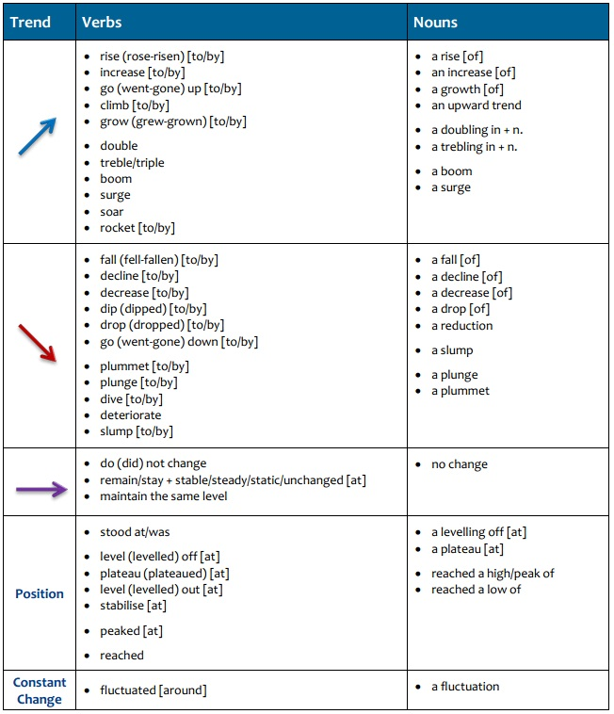

Slide 25
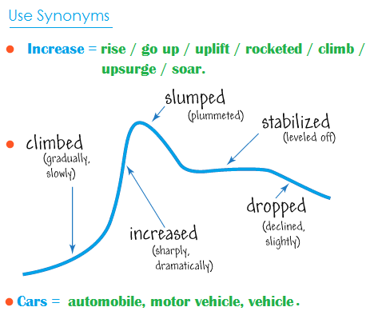

Slide 26
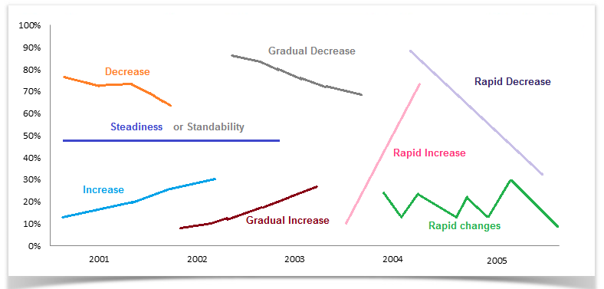

Slide 27
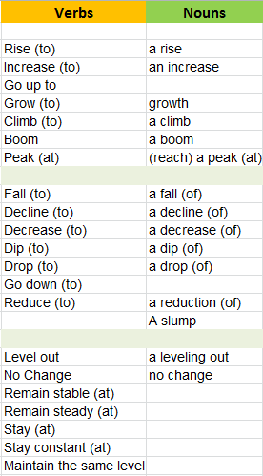

Slide 28
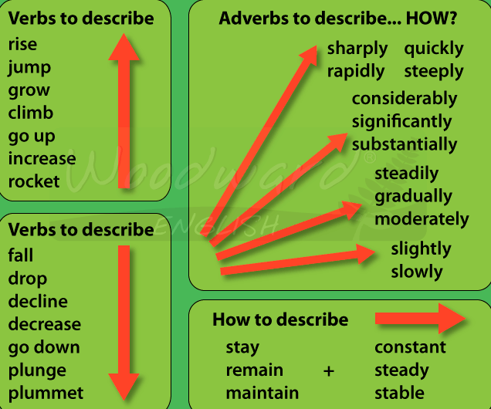

Slide 29
Fill in all the gaps
climb modest overall rocketed steadily upwards
It is of note that the (1) ______ trend for the first six months of the year was (2) ______. After a (3) ______ increase of 10 units sold in February, this figure (4) ______ to approximately 125 in March, and then continued to (5) ______ until it reached nearly 200 by the end of June.

Slide 30
Answers:
overall
steadily upwards
modest
rocketed
climb

Slide 31
Fill in all the gaps
downward dropped slightly slipping spectacular
After starting the period at almost 150 units, sales (1) _____ to around 130 in August. They then rose (2) _____ to 135 in September before (3) _____ back to 130 in October, a (4) _____ trend that continued in November. The period ended with a (5) _____ fall to 60 units sold

Slide 32
Answers:
dropped
slightly
slipping
downward
spectacular

Slide 33
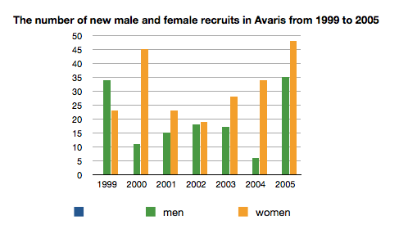
Adjectives and adverbs
Fill in all the gaps
marginal
marginally
overall
steadily
steady
substantial
1. It is immediately apparent that the (1)___ trend is that considerably more women than men were recruited in this period. 2. The number of females employed rose (2) ___ between 2001 and 2004, despite a (3) ___ dip in 2002. 3. There was a very (4) ___ increase in the number of men employed in 2005. 4. There was a (5) ___ rise in the number of females employed between 2001 and 2004, notwithstanding the fact that this number fell (6) ___ in 2002.

Slide 34
Answers:
overall
steadily
marginal
substantial
steady
marginally

Slide 35
Proportion of household income five European countries spend on food and drink, housing, clothing and entertainment
Word choices:
it is evident that
However
shows
a quarter on
the largest
the remaining
ranging between
respectively
while
much less on
 | Food and drink | Housing | Clothing | Entertainment
France | 25% | 31% | 7% | 13%
Germany | 22% | 33% | 15% | 19%
UK | 27% | 37% | 11% | 11%
Turkey | 36% | 20% | 12% | 10%
Spain | 31% | 18% | 8% | 15%
The table 1. ___ the amount of household income that five countries in Europe spend per month on four items. Overall, 2 ___ all five countries spend the majority of their income on food and drink and housing, but 3. ___ clothing and entertainment.
Housing is 4. ___ expenditure item for France, Germany and the UK, with all of them spending around one 5. ____ third of their income on this, at 30%, 33% and 37%,. In contrast, they spend around 6. ___ food and drink. 7. ___, this pattern is reversed for Turkey and Spain, who spend around a fifth of their income on housing, but approximately one third on food and drink.
All five countries spend much less on 8. ___ two items. Regarding clothes, France and Spain spend the least, at less than 10%, 9. ___ the other three countries spend around the same amount, 10. ___ 12% and 15%. At 19%, Germany spends the most on entertainment, whereas UK and Turkey spend approximately half this amount, with France and Spain between the two.

Slide 36
Answers:
1. shows
2. it is evident that
3. much less on
4. the largest
5. respectively
6. a quarter on
7. However
8. the remaining
9. while
10. ranging between

Slide 37
Describing change and making comparison
Look at the cart and complete the sentences describing the data
Between 2004 and 2006, costs (1) _______ dramatically, (2) ________ 50 euros to 100 euros. There was a sharp (3) ________ in profit, which fell from 100 euros to 50 euros over the same (4) _________. By 2006, costs were (5) ________ as high as profit.

Slide 38
Answers
increased / rose
from
drop / decrease / fall
period / time span
twice

Slide 39
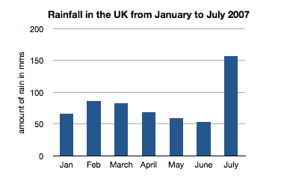
Look at this chart and choose the correct sentences.
There was a decrease of the amount of rainfall in April.
Rainfall increased dramatically in July.
The most rain fell in July when it peaked at just over 150 mm.
The amount of rain rose by just over 150 mm in July.
There was an increase of the amount of rain in February.
There was a steadily decrease in the amount of rain between February and June.

Slide 40
Put the verbs into correct form
The diagrams explain the processes of producing cement and concrete. Overall, there are five stages for making the cement and one for the concrete. The cement must (1. to make) ___ first, as it (2. to use) ___ to make the concrete. To make cement, firstly limestone and clay (3. to feed) ___ into two rollers which (4. to crush) ___ them up into a powder. This power (5. to mix + then) ____ together, before (6. to travel) ____ down a tube and into a rotating heater. The heat comes up from the bottom as the heater rotates, and once the power is ready, it (7. to emerge) ____ from this machine onto a conveyor belt where it (8. to grind + then) into the cement. Finally it (9. to separate) ___ into bags. This cement is then used to produce the concrete. To do this, there is a mixture of 15 per cent cement, 10 per cent water, 25 per cent sand and 50 per cent gravel. These (10. to place) ___ into a concrete mixer, which spins in order to form the concrete.

Slide 41
Answers:
be made
is used
are fed
crush
is then mixed
travelling
emerges
is then ground
is separated
are placed

Slide 42
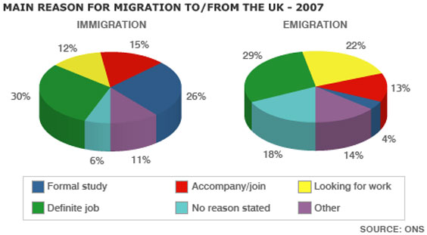
Pie Chart Quiz
1. What is the best way to organize your answer?
а. Write one paragraph about immigration and one about emigration
в. Write about the pie charts together, comparing each of the reasons
2. What tense should you use to write about the pie chart?
а. Past в. Present
3. Can you talk about ‘increases’ and ‘decreases’ when describing the information?
а. Yes в. No

Slide 43
Analyse these two graphs and answer the questions
1. In the line graph, what is the main difference between winter and summer usage?
2. What similarities are there throughout the day at the two times of the year?
3. What uses more electricity in the home than anything else?
4. What is the connection between the data in the two graphs?

Slide 44
Answers
1. Winter usage is much higher.
2. Energy consumption follows a similar pattern throughout the day and peaks at about the same time.
3. Heating and hot water.
4. More energy is used in the winter because of the need for heating at that time of the year.

Slide 45
The Quality of Life in Five Countries
Country | GNP per head (1982: US dollars) | Daily calorie supply per head | Life expectancy at birth (years) | Infant mortality (per 1000 live births)
Bangladesh Bolivia Egypt Indonesia USA | 140 570 690 580 13160 | 1877 2086 2950 2296 3653 | 40 50 56 49 74 | 132 124 97 87 12
What is the table measuring?
What type of language do you need to use (Change? Comparing and contrasting?)
What tense would you use?
Which country has the best quality of life and which has the worst?
What information could you use for an overview / conclusion?
How could you group the information?
How many paragraphs would you have and what you would write about in each one?

Slide 46
Model Answer
The table uses four economic indicators to show the standard of living in five selected countries in 1982. Overall, it can be seen that the quality of life in the USA was far higher than the other four countries.
To begin, the USA, which is a developed country, had the highest GNP at 13,160 dollars per head. It also had a much higher daily calorie intake and life expectancy, and the lowest rate of infant mortality.
The other developing countries had quality of life ratings that were significantly lower. The range of indicators for Egypt, Indonesia and Bolivia were similar, with Egypt having the highest quality of life amongst the three. However, the infant mortality rate in Egypt’s was slightly higher than Indonesia’s at 97 deaths per 1000 compared to78 in Indonesia.
Bangladesh had by far the lowest quality of life in all the indicators. Its GNP was one hundred times smaller than the USA’s. Its calorie intake and life expectancy were about half those of the USA, and its infant mortality rate was 10 times greater.

Slide 47
Memo
Whether you have to describe a graph, table or chart, think carefully about what you need to include in your description. Don’t describe every detail of the information. Choose the most important and interesting features to write about.
Support your description with figures, but you don’t need to give every number exactly. You can be approximate by using words like “over”, “about” and “around”.
Sometimes you will have to describe a diagram showing a process. Identify all the stages of the process clearly before writing about it. Remember that if there are any difficult technical words in the diagram, chart or graph, they will be explained.
Use words in your description that show the sequence of the process.
Analyse the question. Think carefully about what you are being asked to do.
Decide on your position and then plan your writing carefully by making notes and organizing them into paragraphs. Make sure that each paragraph has a clear focus.
Include examples to support your opinion.
Leave enough time to edit and check your writing. It’s important to look for grammar and spelling mistakes, which are easy to make when you are writing to a time limit.
Check your work. Do you have any particular mistakes that you often tend to make? e.g. leaving out articles? Know your own typical mistakes and check your work carefully for them.

Slide 48
Типичные ошибки
Грамматические, орфографические и пунктуационные ошибки.
Незавершённые или логически неверные предложения.
Превышение или недобор рекомендуемого количества слов.
Переписанные слово в слово фразы из задания.
Слишком длинные и витиеватые предложения.
Отступление от темы.
Повторение одной и той же мысли разными словами.
Отсутствие логической связи между высказываниями.

